Slide 1
How to Parse JSON Data

Slide 2
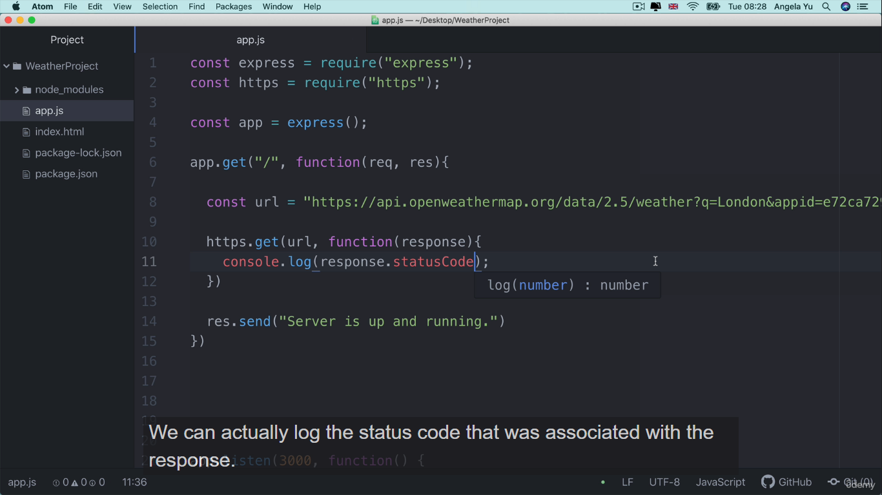
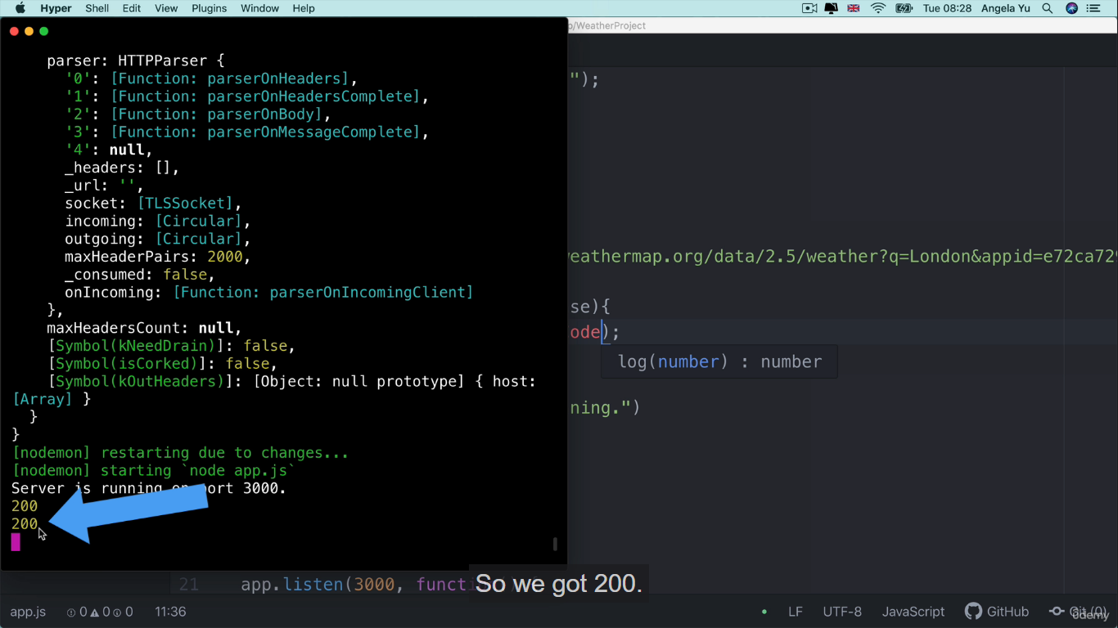
Add statusCode at response object
Once we refresh the browser then we can see 200 at hyper terminal

Slide 3
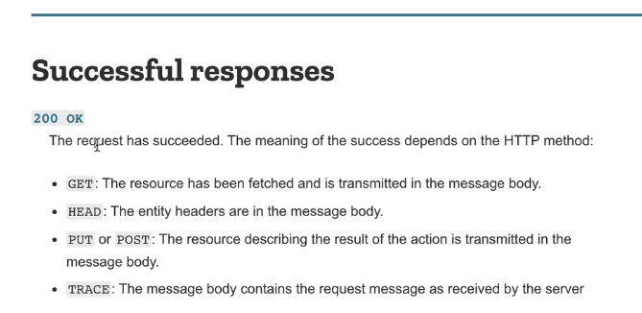

Slide 4
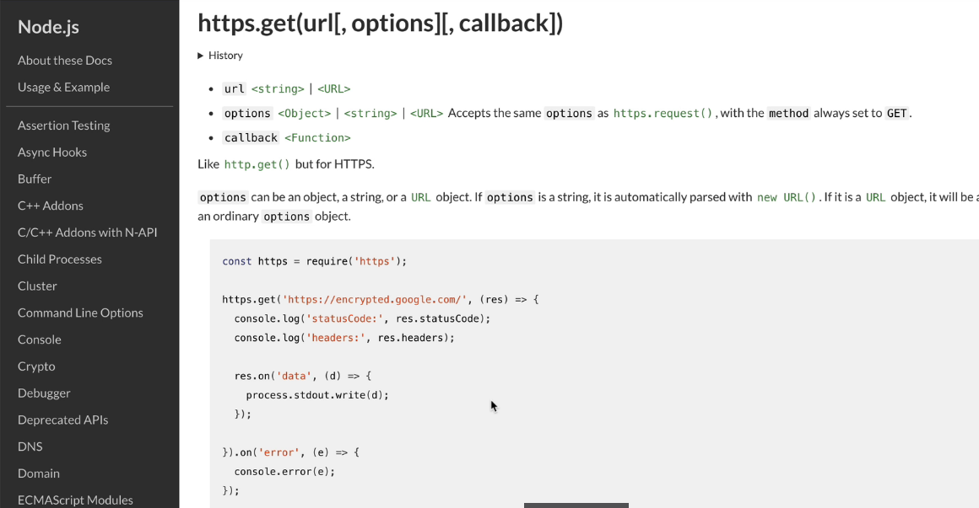

Slide 5
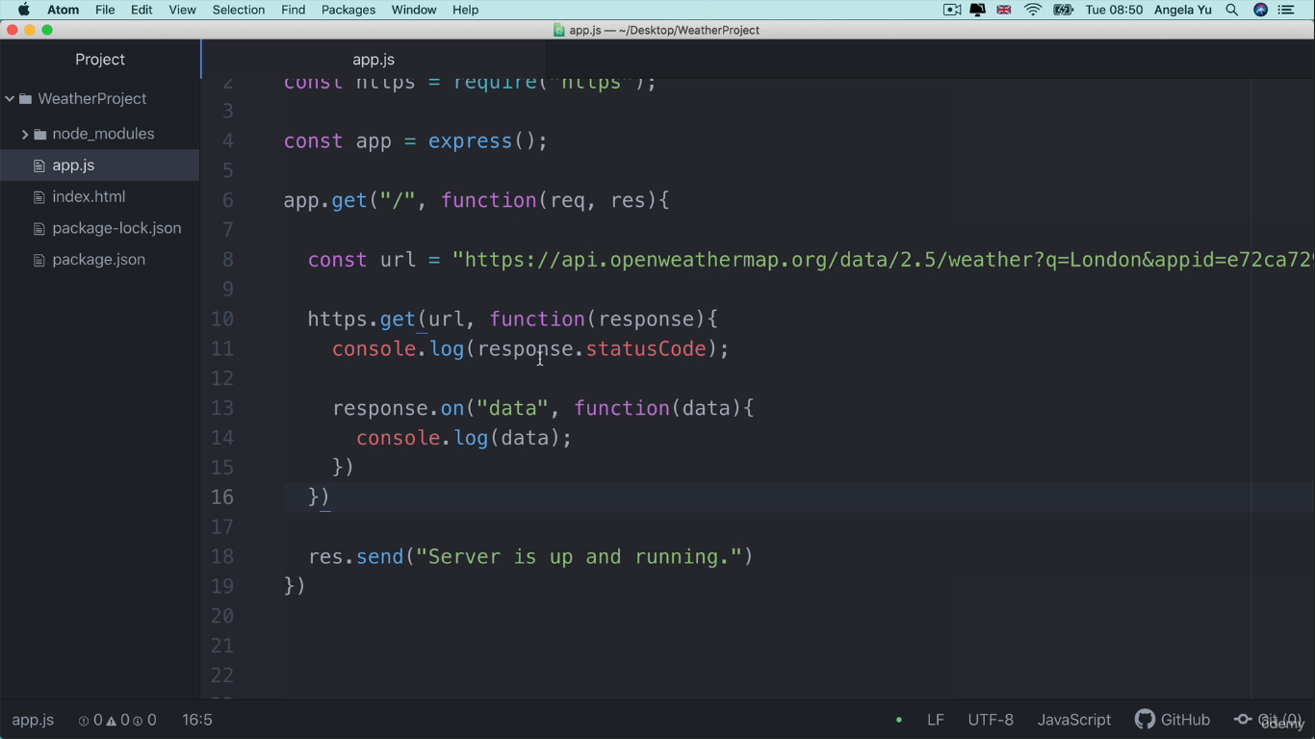
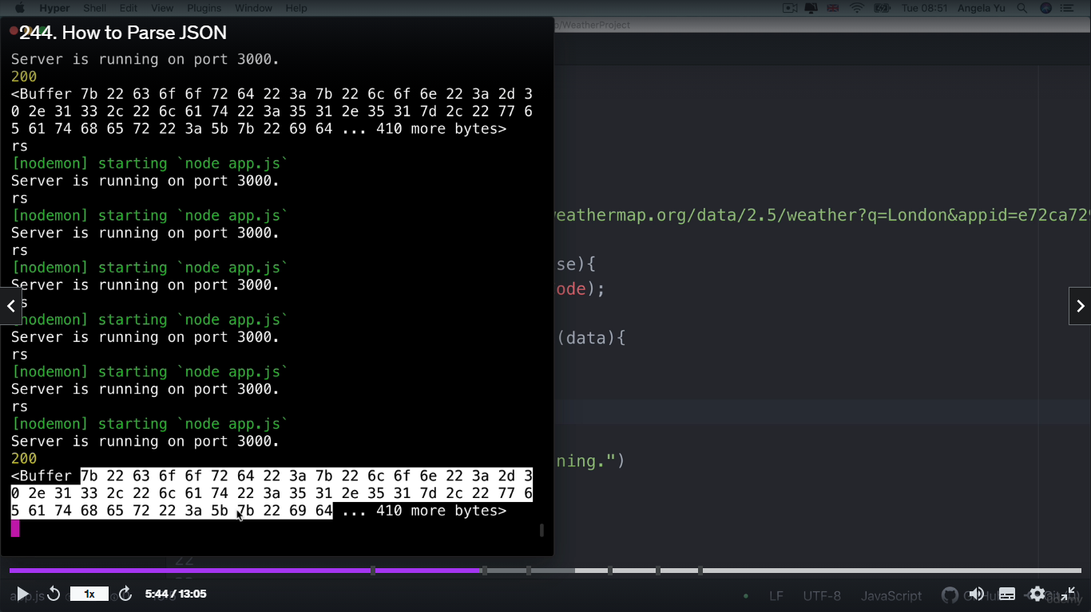

Slide 6
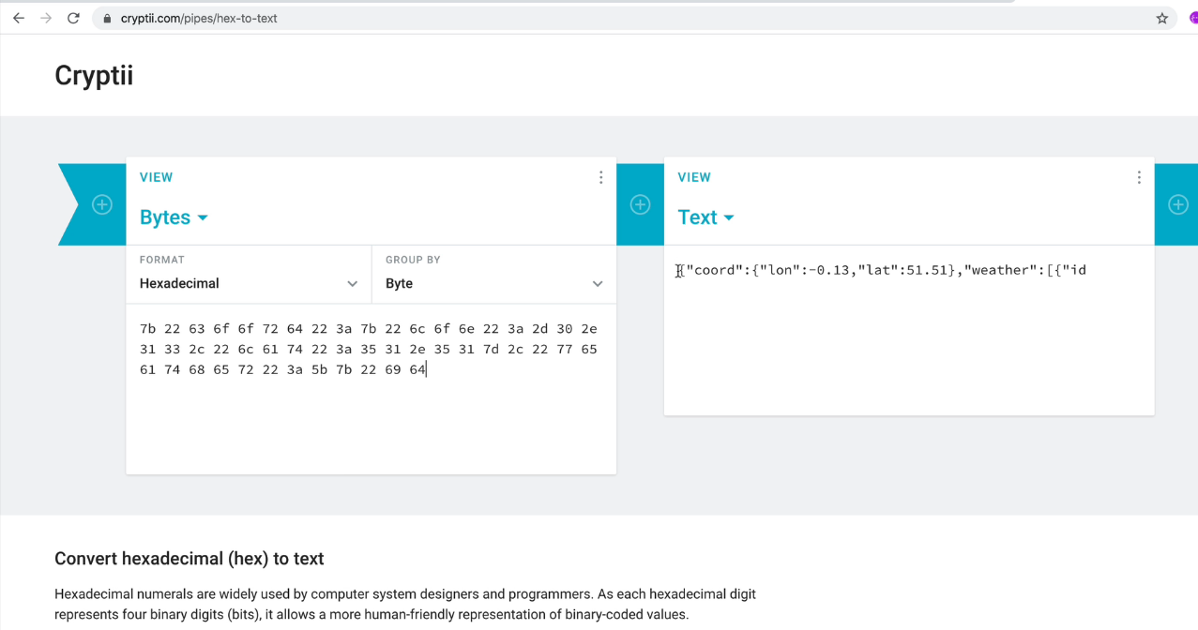

Slide 7
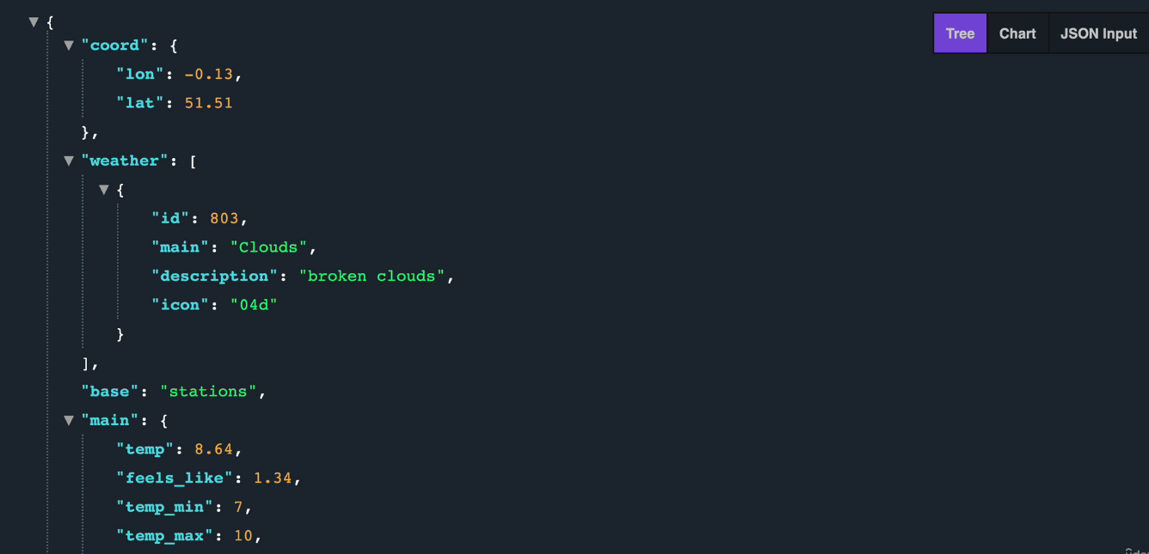

Slide 8
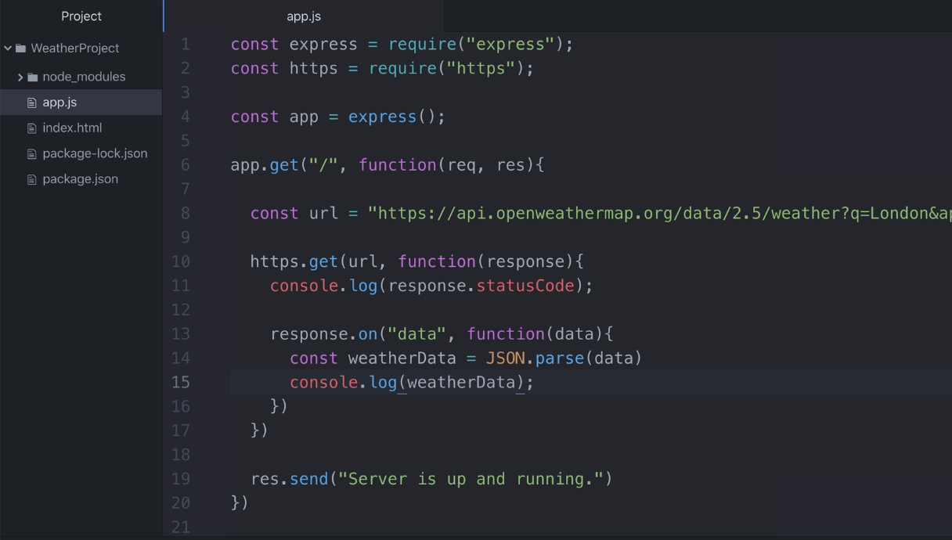

Slide 9
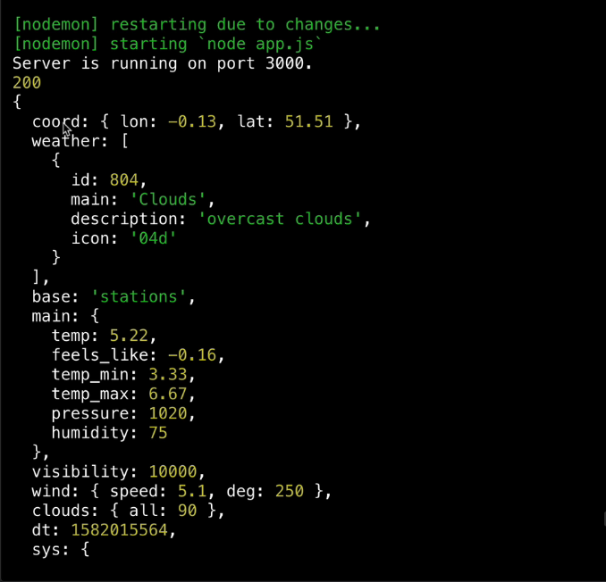

Slide 10
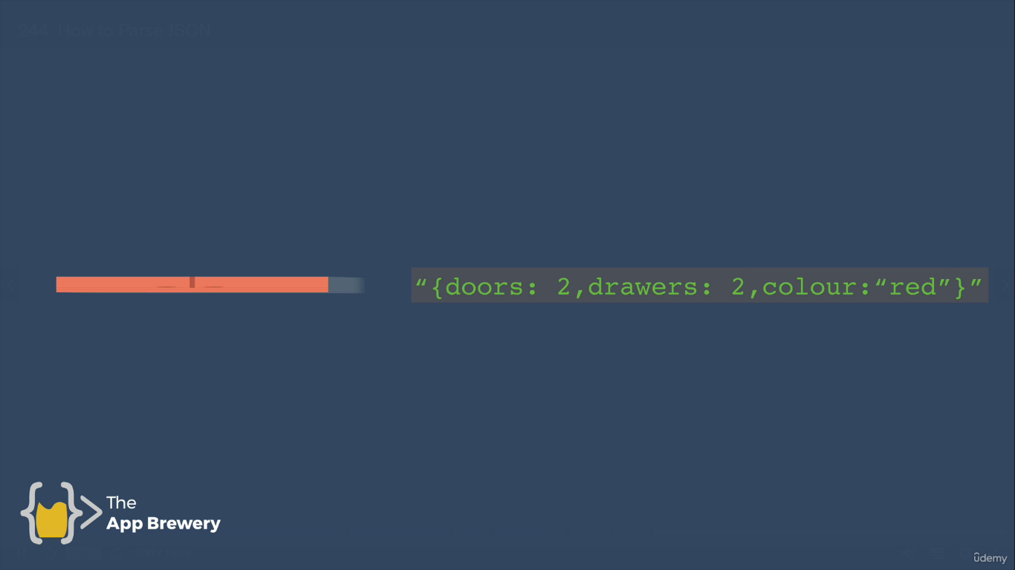
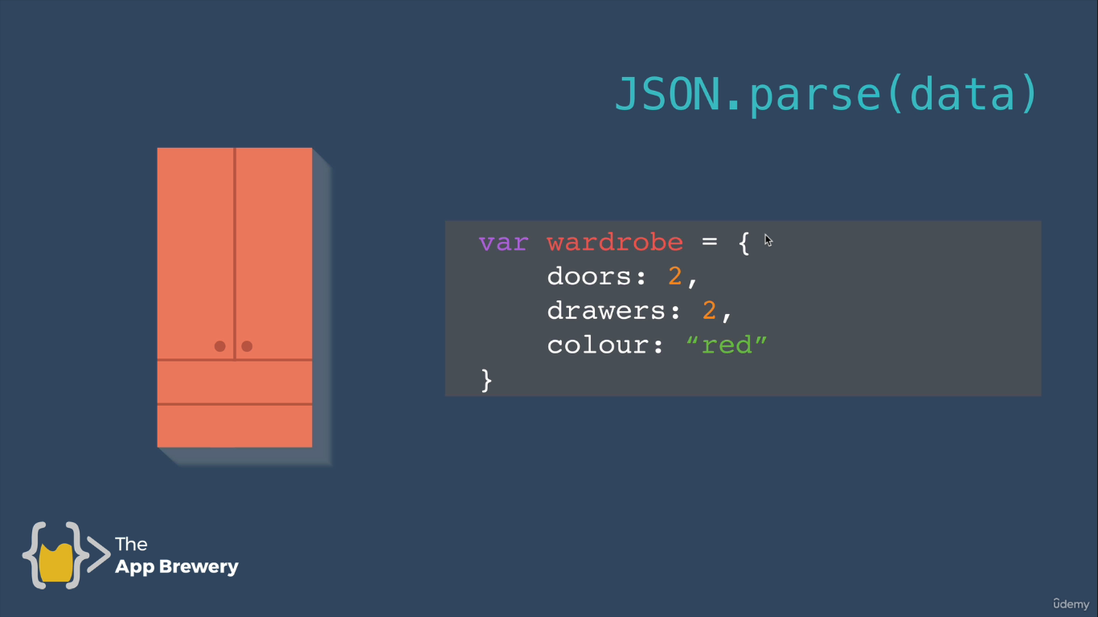

Slide 11
const object = {
name:"RVS-MCA",
subject:"Back end Node JS"
}
console.log(JSON.stringify(object))
{"name":"RVS-MCA","subject":"Back end Node JS"}

Slide 12
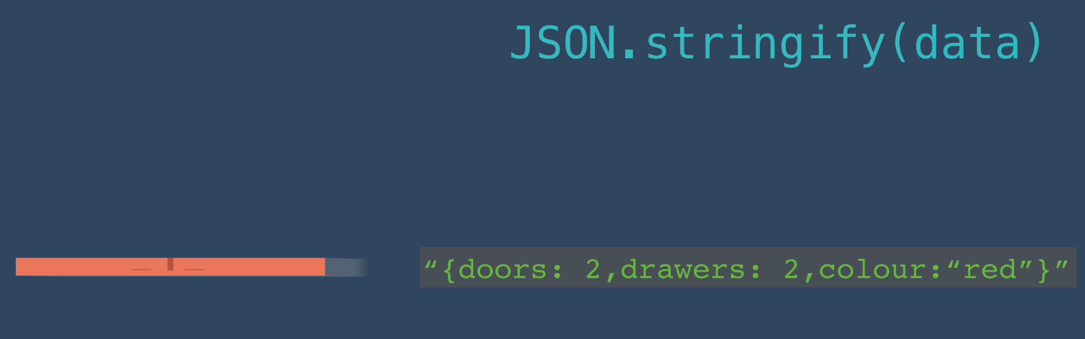

Slide 13
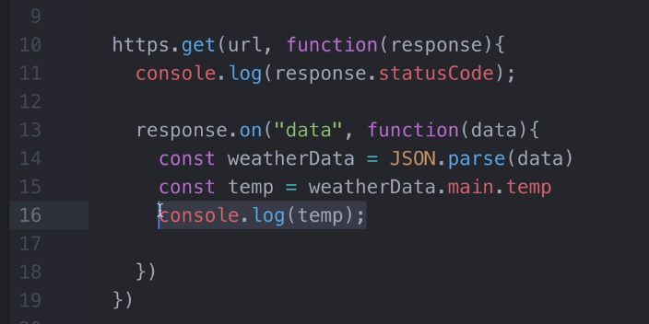
To print temp value from actual result

Slide 14
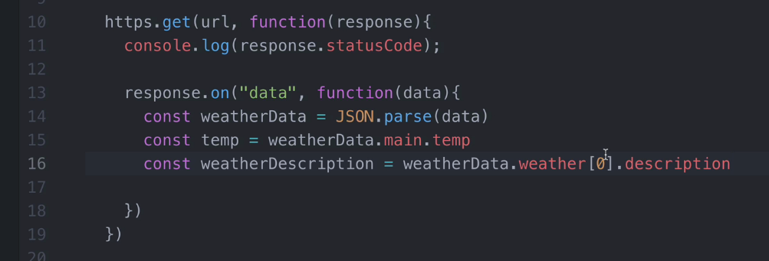
To print description value from actual result

Slide 15
Using express to render a website with
Live API Data

Slide 16
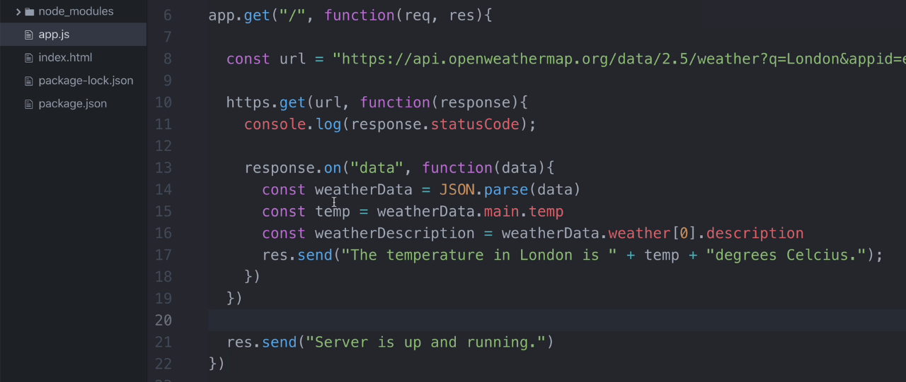
When we extract temp from get / route, there
are may be use of res object two times mistakenly

Slide 17
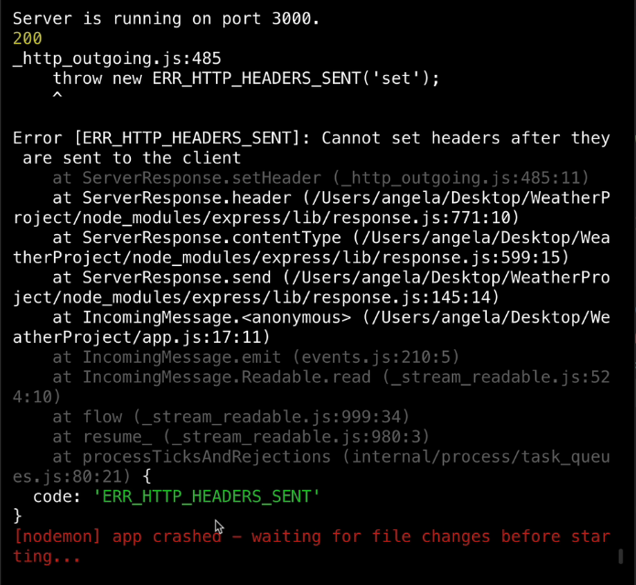

Slide 18
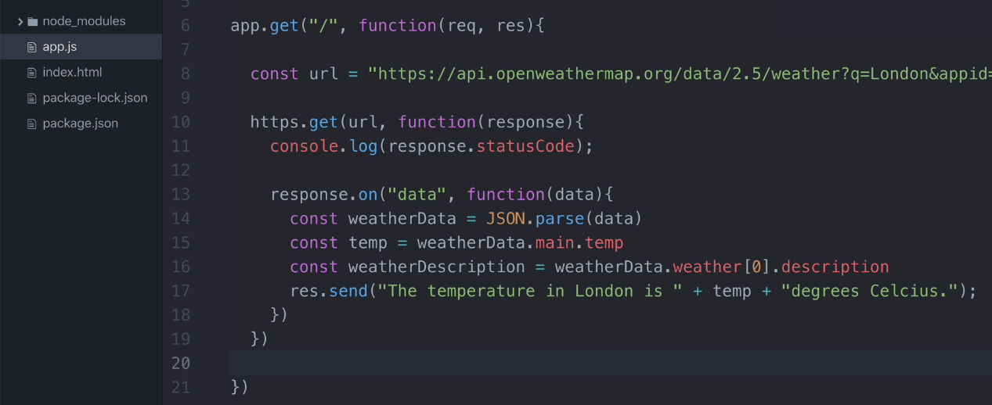
So remove last res.send() and execute code

Slide 19


Slide 20
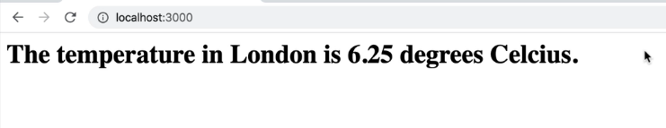
How will you bring following result using <h1> tag ?

Slide 21
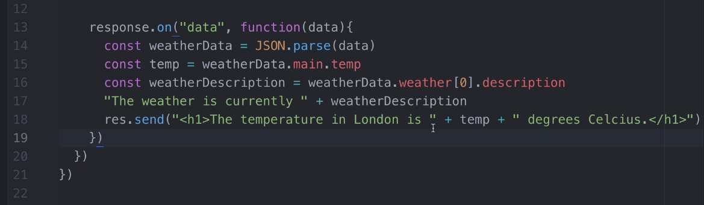
How will you display description along with temp?

Slide 22
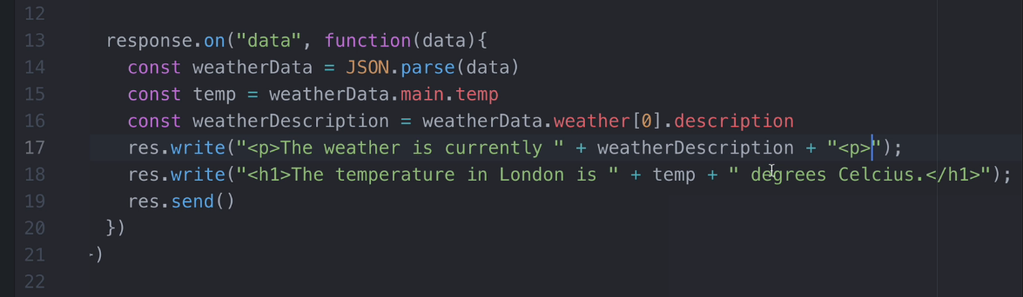
Many res.write() and one res.send()

Slide 23
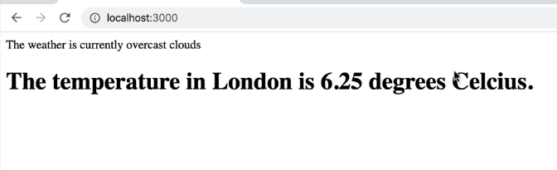

Slide 24
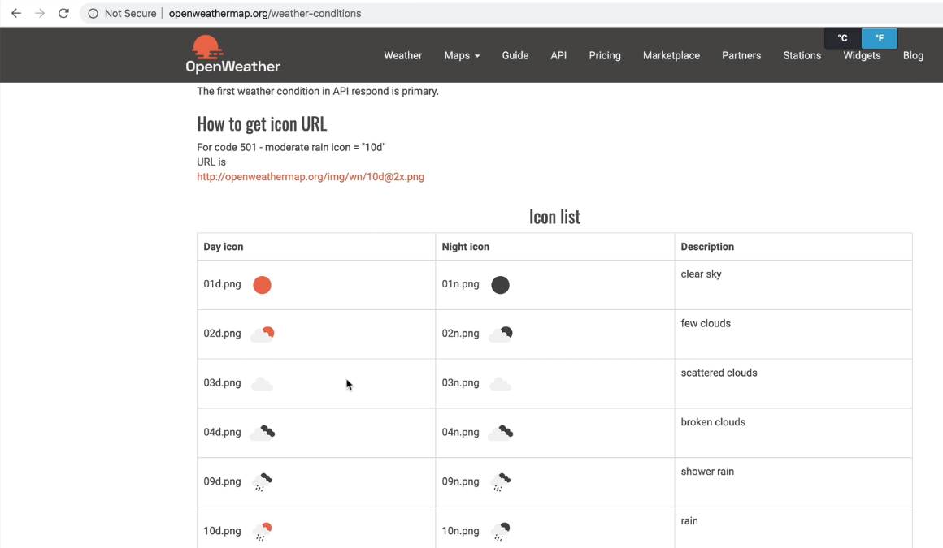

Slide 25
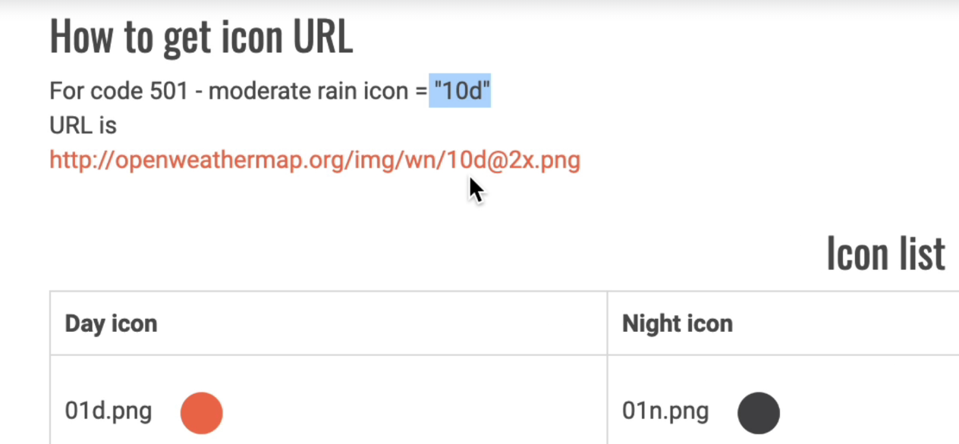

Slide 26
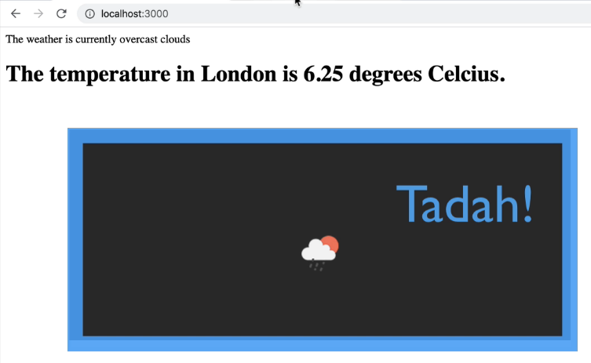
How to bring image from API Data?

Slide 27
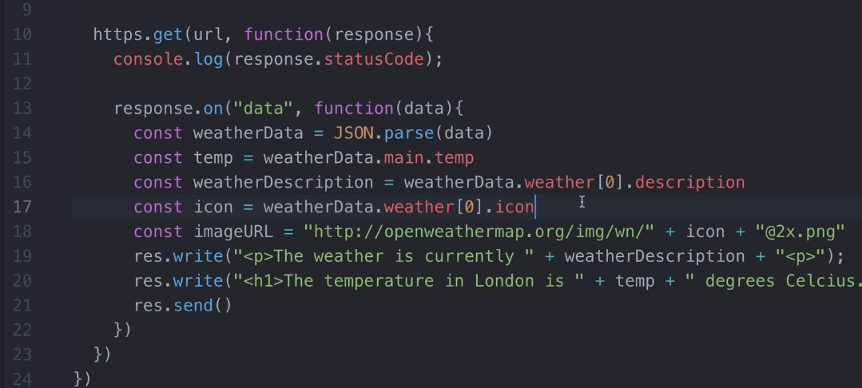
Storing icon value and concatenating inside path

Slide 28
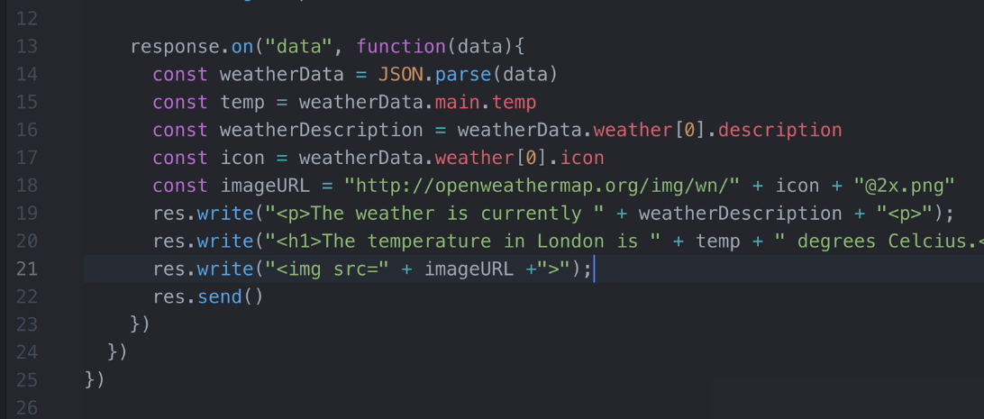
Printing image inside <img> tag and adding path
at src attribute

Slide 29
